Slide 1


Data Structure
Course Code : ENCS205
Dr Swati Gupta
Associate Professor, School of Engineering & Technology
K.R. Mangalam University
Unit 4 :Trees and Graphs
Notes:
New Courses replaced with New Programmes

Slide 2

BINARY SEARCH TREES
Session 49
Operations on BST(Deletion and Searching a Node)
Brainstorming Session
Notes:
New Courses replaced with New Programmes

Slide 3
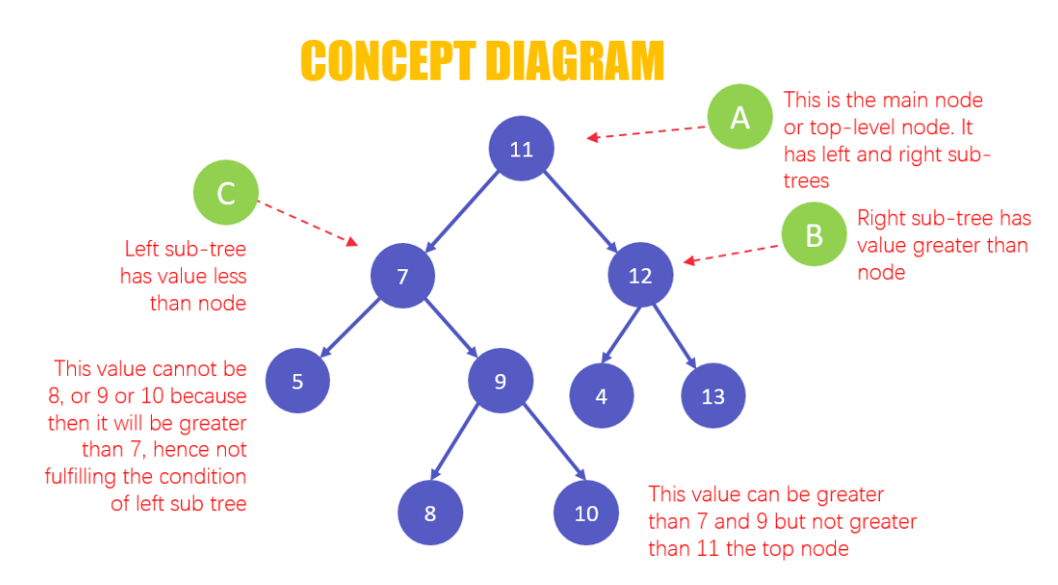
RECAP
A binary search tree(BST) is a special type of binary tree and is also known as a sorted or ordered binary tree.
In a binary search tree the two properties are obeyed:
The value of the left node is less than the value of the
parent node.
The value of the right node is greater than the value of the parent node.
Notes:
New Courses replaced with New Programmes

Slide 4

Operations on Binary Search Tree
Searching a Node in BST
Insertion a new Node in BST
Deleting a Node in BST

Slide 5
Inserting a New Node In BST : Algorithm
1. Create a new BST node and assign values to it.
2. insert(node, key)
i) If root == NULL,
return the new node to the calling function.
ii) if root=>data < key
call the insert function with root=>right and assign the return
value in root=>right.
root->right = insert(root=>right,key)
Notes:
New Courses replaced with New Programmes

Slide 6
Inserting a New Node In BST : Algorithm
iii) if root=>data > key
call the insert function with root->left and assign the return value in root=>left.
root=>left = insert(root=>left,key)
3. Finally, return the original root pointer to the calling function
Notes:
New Courses replaced with New Programmes

Slide 7
Inserting a New Node In Binary Search Tree : Pseudo code
Tree-Insert(T, z)
y ← NIL
x ← root[T]
while x ≠ NIL
do y ← x
if key[z] < key[x]
then x ← left[x]
else x ← right[x]
p[z] ← y
if y = NIL
then root[t] ← z
else if key[z] < key[y]
then left[y] ← z
else right[y] ← z
Notes:
New Courses replaced with New Programmes

Slide 8
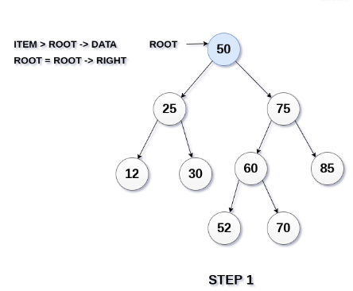
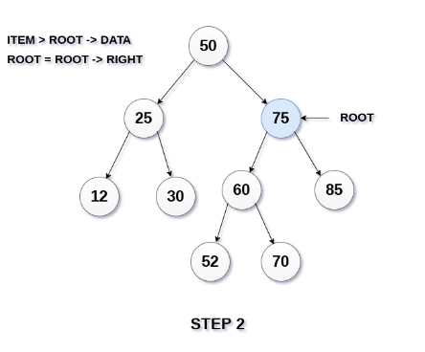
Inserting a New Node In Binary Search Tree :Example
Suppose ITEM = 95 in BST
Notes:
New Courses replaced with New Programmes

Slide 9
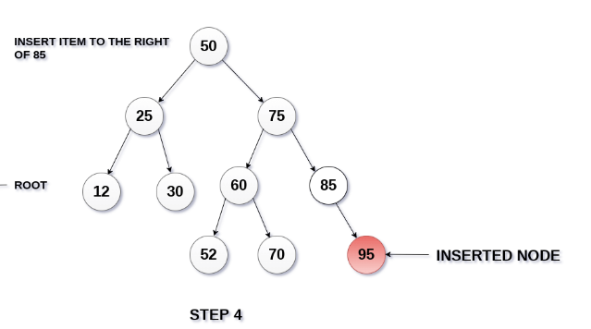
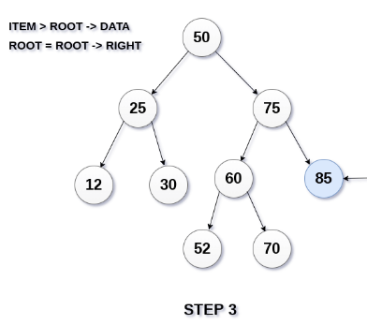
Inserting a New Node In Binary Search Tree :Example
Suppose ITEM = 95 in BST
Notes:
New Courses replaced with New Programmes

Slide 10
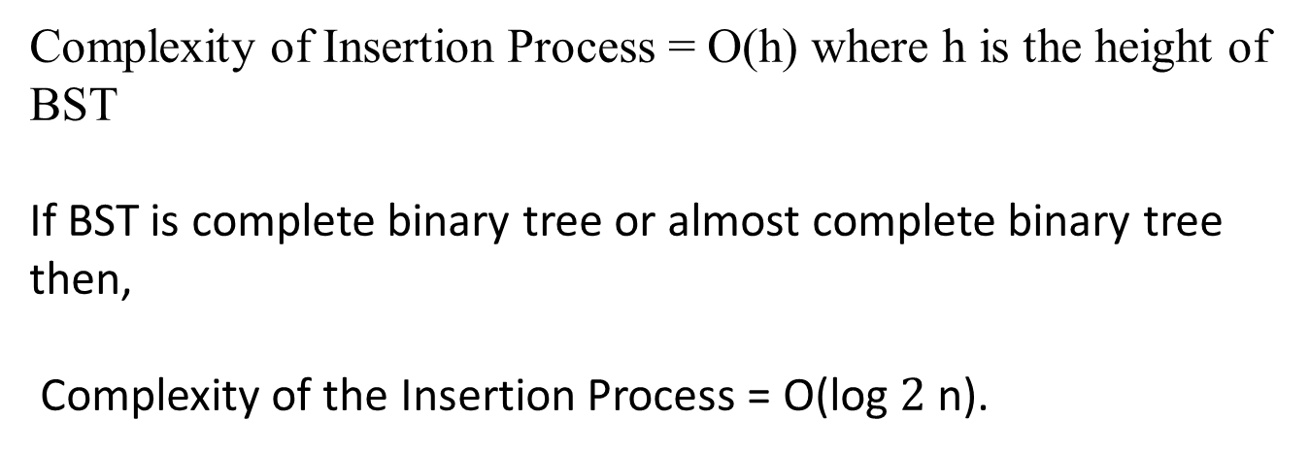
Complexity of Inserting a New Node In Binary Search Tree
Complexity of Insertion Process = O(h) where h is the height of BST
If BST is complete binary tree or almost complete binary tree then,
Complexity of the Insertion Process = O(log $2$ n).
Notes:
New Courses replaced with New Programmes

Slide 11

Searching a Node in Binary Search Tree
Function to insert a node in the binary search tree
TreeNode* insertNode(TreeNode* root, int value) {
// If the tree is empty, create a new node and return it
if (root == nullptr) {
return new TreeNode(value);
}
// Otherwise, recursively insert the node in the appropriate position
if (value < root->data) {
root->left = insertNode(root->left, value);
} else {
root->right = insertNode(root->right, value);
}
return root;
}
Access the Complete Code :https://onlinegdb.com/RhKosnZbr.

Slide 12
Searching a Node in Binary Search Tree
Function to search for a node in the binary search tree
TreeNode* searchNode(TreeNode* root, int value) {
// If the tree is empty or the value is found, return the root
if (root == nullptr || root->data == value) {
return root;
}
// Otherwise, recursively search the left or right subtree
if (value < root->data) {
return searchNode(root->left, value);
} else {
return searchNode(root->right, value);
}
}

Slide 13
Deleting a Node from Binary Search Tree
1. Search the node which needs to be deleted.
Case 1: if node doesn’t have any child then set the parent’s pointer to NULL and delete the node.
Case 2: If node has one child then set the parent’s pointer to the child and delete the node.
Case 3 : If node has two child then
set the parent’s pointer to right child of the node.
insert the node’s left child as the child of node’s right child to it’s appropriate place
Notes:
New Courses replaced with New Programmes

Slide 14
Deleting a Node from Binary Search Tree
Deletion operation needs to keep the property of BSTs.
Case 1: Deleting a node that has no children.
For example, deleting node 78 in the tree below.
45
45
45
45
39
56
39
56
39
56
39
56
54
78
54
78
54
78
54
55
55
55
55
Notes:
New Courses replaced with New Programmes

Slide 15
Deleting a Node from Binary Search Tree
Case 2: Deleting a node with one child (either left or right).
if the node was the left child of its parent, the node’s child becomes the left child of the node’s parent.
Correspondingly, if the node was the right child of its parent, the node’s child becomes the right child of the node’s parent.
45
45
45
45
39
56
39
56
39
56
39
56
54
78
54
78
54
78
54
55
55
55
55
Notes:
New Courses replaced with New Programmes

Slide 16
Deleting a Node from Binary Search Tree
Case 3: Deleting a node with two children.
We replace the node’s value with its in-order predecessor (largest value in the left sub-tree) or in-order successor (smallest value in the right sub-tree).
The in-order predecessor or the successor can then be deleted using any of the above cases.
45
45
45
45
39
56
39
56
39
55
39
55
54
78
54
78
54
78
54
78
55
80
55
80
55
80
80
Notes:
New Courses replaced with New Programmes

Slide 17
Deleting a New Node In Binary Search Tree : Pseudo code
Delete (TREE, VAL)
Step 1: IF TREE = NULL, then
Write “VAL not found in the tree”
ELSE IF VAL < TREE->DATA
Delete(TREE->LEFT, VAL)
ELSE IF VAL > TREE->DATA
Delete(TREE->RIGHT, VAL)
ELSE IF TREE->LEFT AND TREE->RIGHT
SET TEMP = findLargestNode(TREE->LEFT)
SET TREE->DATA = TEMP->DATA
Delete(TREE->LEFT, TEMP->DATA)
ELSE
Notes:
New Courses replaced with New Programmes

Slide 18
Deleting a New Node In Binary Search Tree : Pseudo code
SET TEMP = TREE
IF TREE->LEFT = NULL AND TREE ->RIGHT =
NULL
SET TREE = NULL
ELSE IF TREE->LEFT != NULL
SET TREE = TREE->LEFT
ELSE
SET TREE = TREE->RIGHT
[END OF IF]
FREE TEMP
[END OF IF]
Step 2: End
Notes:
New Courses replaced with New Programmes

Slide 19
Deleting a Node in Binary Search Tree
Function to delete a node in the binary search tree
TreeNode* deleteNode(TreeNode* root, int value) {
// If the tree is empty, return null
if (root == nullptr) {
return root;
}
Access the Complete Code:https://onlinegdb.com/VpbBccw9w.

Slide 20
Deleting a Node in Binary Search Tree
Function to Find the node to be deleted
if (value < root->data) {
root->left = deleteNode(root->left, value);
} else if (value > root->data) {
root->right = deleteNode(root->right, value);
} else {
// Node found
Access the Complete Code:https://onlinegdb.com/VpbBccw9w.

Slide 21
Deleting a Node in Binary Search Tree
Node with only one child or no child
if (root->left == nullptr) {
TreeNode* temp = root->right;
delete root;
return temp;
} else if (root->right == nullptr) {
TreeNode* temp = root->left;
delete root;
return temp;
}
Access the Complete Code:https://onlinegdb.com/VpbBccw9w.

Slide 22
Deleting a Node in Binary Search Tree
Function to search for a node in the binary search tree
TreeNode* searchNode(TreeNode* root, int value) {
// If the tree is empty or the value is found, return the root
if (root == nullptr || root->data == value) {
return root;
}
// Otherwise, recursively search the left or right subtree
if (value < root->data) {
return searchNode(root->left, value);
} else {
return searchNode(root->right, value);
}
}

Slide 23
Deleting a Node in Binary Search Tree
Node with two children
TreeNode* temp = findMin(root->right);
// Copy the inorder successor's content to this node
root->data = temp->data;
// Delete the inorder successor
root->right = deleteNode(root->right, temp->data);
}

Slide 24
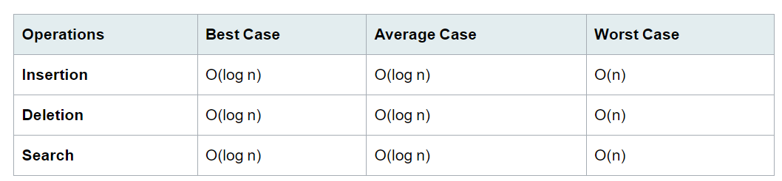
Time Complexity Analysis of BST
Notes:
New Courses replaced with New Programmes

Slide 25
Test Your Knowledge
Q1 In delete operation of BST, we need inorder successor (or predecessor) of a node when the node to be deleted has both left and right child as non-empty. Which of the following is true about inorder successor needed in delete operation?
(A) Inorder Successor is always a leaf node
(B) Inorder Successor is always either a leaf node or a node with empty left child.
(C) Inorder successor may be an ancestor of the node
(D) Inorder successor is always either a leaf node or a node with empty right child
Answer (B)
Q2 Suppose the numbers 7, 5, 1, 8, 3, 6, 0, 9, 4, 2 are inserted in that order into an initially empty binary search tree. The binary search tree uses the usual ordering on natural numbers. What is the in-order traversal sequence of the resultant tree? (A) 7 5 1 0 3 2 4 6 8 9 (B) 0 2 4 3 1 6 5 9 8 7 (C) 0 1 2 3 4 5 6 7 8 9 (D) 9 8 6 4 2 3 0 1 5
Answer (C)
Notes:
New Courses replaced with New Programmes

Slide 26
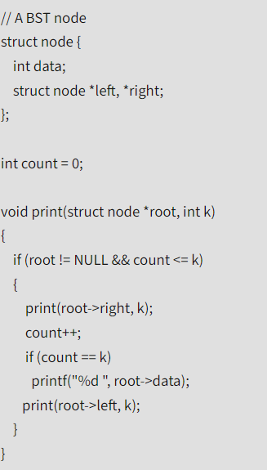
Test Your Knowledge
Q3 What does the function print() do in general? The function print() receives root of a Binary Search Tree (BST) and a positive integer k as arguments.
(A) Prints the kth smallest element in BST
(B) Prints the kth largest element in BST
(C ) Prints the right most node at level k from root
(D) Prints the left most node at level k from root
Answer (B)
Notes:
New Courses replaced with New Programmes

Slide 27
Test Your Knowledge
Q4 The following numbers are inserted into an empty binary search tree in the given order: 10, 1, 3, 5, 15, 12, 16. What is the height of the binary search tree (the height is the maximum distance of a leaf node from the root)?
(A) 2
(B) 3
(C) 4
(D) 6
Answer (B)
Q5 While inserting the elements 71, 65, 84, 69, 67, 83 in an empty binary search tree (BST) in the sequence shown, the element in the lowest level is
(A) 65
(B) 67
(C) 69
(D) 83
Answer (B)
Notes:
New Courses replaced with New Programmes

Slide 28
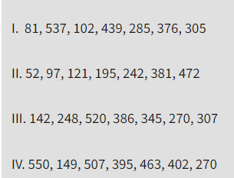
Test Your Knowledge
Q6 The number of ways in which the numbers 1, 2, 3, 4, 5, 6, 7 can be inserted in an empty binary search tree, such that the resulting tree has height 6, is _____________
(A) 2
(B) 4
(C) 64
(D) 32
Answer (C)
Q7 A Binary Search Tree (BST) stores values in the range 37 to 573. Consider the following sequence of keys. Which all of the above sequences list nodes in the order in which we could have encountered them in the search?
(A) II and III only
(B) I and III only
(C) III and IV only (D) III only
Answer: (D)
Notes:
New Courses replaced with New Programmes

Slide 29
REVIEW
A binary search tree(BST) is a special type of binary tree where two properties are obeyed:
The value of the left node is less than the value of the
parent node.
The value of the right node is greater than the value of the parent node.
Notes:
New Courses replaced with New Programmes

Slide 30
References
https://www.youtube.com/watch?v=oSWTXtMglKE
https://www.upgrad.com/blog/5-types-of-binary-tree/
https://www.javatpoint.com/tree
https://www.geeksforgeeks.org/tree-data-structure/
https://www.sanfoundry.com/1000-data-structure-questions-answers/
https://www.tutorialspoint.com/data_structures_algorithms/array_data_structure.htm
https://www.tutorialspoint.com/data_structures_algorithms/tree_data_structure.htm
https://www.simplilearn.com/tutorials/data-structure-tutorial/trees-in-data-structure
https://www.scaler.com/topics/data-structures/tree-data-structure/
Notes:
New Courses replaced with New Programmes

Slide 31
THANK YOU

